Slide 1
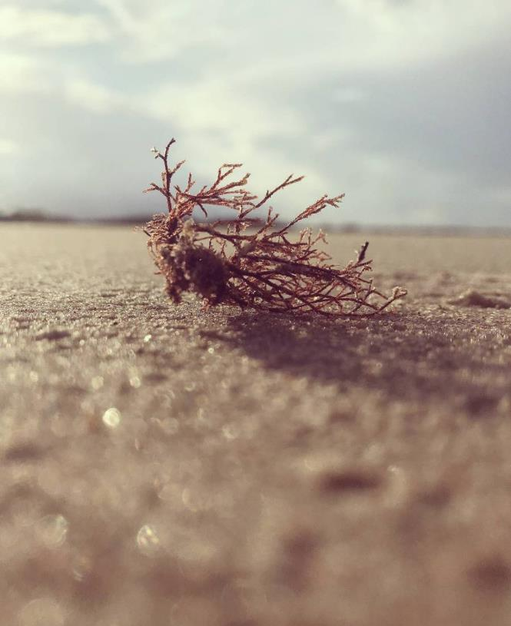
Kubernetes
Nayan Dhoble

Slide 2
What is Kubernetes ?
Kubernetes is a container management technology developed in Google lab to manage containerized applications in different kind of environments such as physical, virtual, and cloud infrastructure. It is an open source system which helps in creating and managing containerization of application.
It is written in Golang.
It is also known as “kube” or k8s as there are 8 characters in between K and S in Kubernetes.

Slide 3
What is container orchestration tool?
Container orchestration tool manages containerized applications.
The container orchestration tool automates deploying, scaling and managing
containerized application on a group of server.
The mostly used container orchestration tool is Kubernetes, Docker swarm and
Apache -mesos.

Slide 4
Features of Kubernetes
Continues development, integration and deployment
Containerized infrastructure
Application-centric management
Auto-scalable infrastructure
Environment consistency across development testing and production
Loosely coupled infrastructure, where each component can act as a separate unit
Higher density of resource utilization
Predictable infrastructure which is going to be created

Slide 5
Architecture of Kubernetes
NODE:
► A Node is a worker machine in Kubernetes and may be either a virtual or a
physical machine, depending on the cluster.
► Each Node is managed by the control plane.
► A Node can have multiple pods, and the Kubernetes control plane
automatically handles scheduling the pods across the Nodes in the cluster.
► There are two types of nodes:
- Master Node
- Worker Node

Slide 6
Master node
The master node is responsible for running several Kubernetes processes that
are necessary to run and manage the cluster properly
1. API Server - Acts as the frontend to the cluster. All external communication to
the cluster is via the API Server.
2. Scheduler - Scheduler ensures proper pod placement on the worker nodes
based on several factors such as the available resources and the current load on
the cluster.
3. Controller Manager :- This keeps track of the state of the cluster.
4. Etcd - Kubernetes uses etcd to store all its data .its configurationdata, its state, and its metadata.

Slide 7
worker nodes
The worker nodes are part of the Kubernetes clusters which actually execute the
containers and applications on them.
They have two main components
1. Kubelet Service - Each worker node has a Kubelet process running on it that
allows the cluster to talk to each other and execute some tasks on the worker
nodes, such as running application processes. It listens for instructions from
the API Server and manages containers running on the node.
2. Kube-proxy Service - The Kube-Proxy Service is responsible for enabling
communication between services within the cluster.

Slide 8
POD:
► A Pod is a collection of containers and its storage inside a node of a Kubernetes
cluster. It is possible to create a pod with multiple containers inside it.
► For example, keeping a database container and data container in the same
pod.

Slide 9
Commands for Kubernetes
► Get version-related information
kubectl version
► Get configuration details
kubectl config view
► Create deployment
kubectl create deployment <deploy name> –image=<image name>
► Delete deployment
kubectl delete deploy <deploy name>

Slide 10
► List all current pods
kubectl get pods
► Describe pod names
kubectl describe pod<name>
► To scale the replication counter, counting the number of instances
kubectl scale -replicas=<count>rc<name>
► Stopping all pods in <n>
kubectl drain<n>– delete-local-data–force–ignore-daemonset

Slide 11
► Lists Services
kubectl get svc
► Deletes a pod
kubectl delete pod<name>

Slide 12

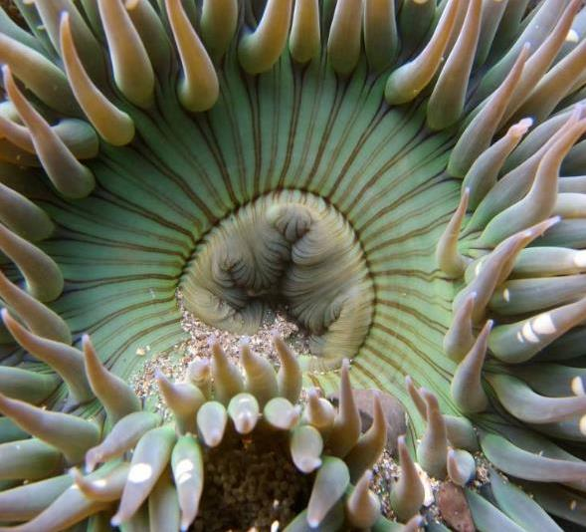
Agenda
Introduction​
Primary goals​
Areas of growth​
Timeline​
Summary​

Slide 13

Introduction
At Contoso, we empower organizations to foster collaborative thinking to further drive workplace innovation. By closing the loop and leveraging agile frameworks, we help business grow organically and foster a consumer first mindset.​

Slide 14
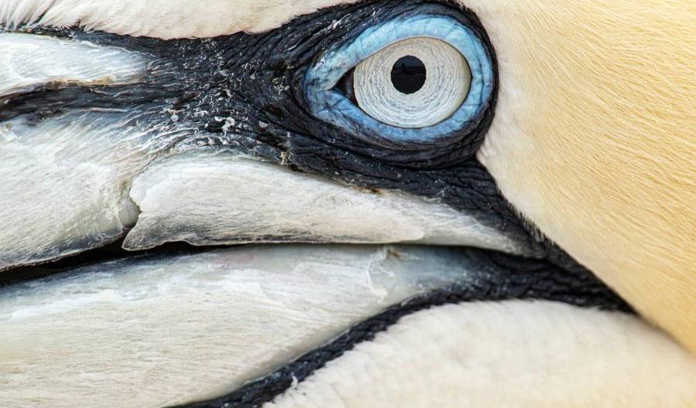
Primary Goals
Annual revenue growth

Slide 15
Quality Performance

Slide 16
Areas of growth

Slide 17

Business opportunities are like buses. There's always another one coming.
Richard Branson

Slide 18




Our Team
Takuma Hayashi​​
Mirjam Nilsson​​
President​
Chief Executive Officer​
Flora Berggren​​
Rajesh Santoshi​
Chief Operations Officer​
VP Marketing​

Slide 19








Our Team
Takuma Hayashi​
Mirjam Nilsson​
Flora Berggren​​
Rajesh Santoshi​
President​
Chief Executive Officer​
Chief Operations Officer​
VP Marketing​
Graham Barnes
Rowan Murphy​
Elizabeth Moore​
Robin Kline​
VP Product​
SEO Strategist​
Product Designer​
Content Developer​

Slide 20
Plan For Product Launch
Planning
Marketing
Design
Strategy
Launch
Synergize scalable
e-commerce
Disseminate standardized metrics
Coordinate
e-business applications
Foster holistically superior methodologies
Deploy strategic networks with compelling
e-business needs

Slide 21
Timeline
Sep 20xx
Jan 20xx
May 20xx
Synergize scalable
e-commerce
Coordinate e-business applications
Deploy strategic networks with compelling e-business needs
Nov 20xx
Mar 20xx
Disseminate standardized metrics
Foster holistically superior methodologies

Slide 22
Areas of Focus
B2B market scenarios​
Cloud-based opportunities​
Develop winning strategies to keep ahead of the competition​
Capitalize on low hanging fruit to identify a ballpark value​
Visualize customer directed convergence​
Iterative approaches to corporate strategy​
Establish a management framework from the inside​

Slide 23
How we get there
ROI​
Niche markets​
Supply chains​
Envision multimedia-based expertise and cross-media growth strategies​
Visualize quality intellectual capital​
Engage worldwide methodologies with web-enabled technologies​
Pursue scalable customer service through sustainable strategies​
Engage top-line web services with cutting-edge deliverables​
Cultivate one-to-one customer service with robust ideas​
Maximize timely deliverables for real-time schemas​

Slide 24

Summary
At Contoso, we believe in giving 110%. By using our next-generation data architecture, we help organizations virtually manage agile workflows. We thrive because of our market knowledge and great team behind our product. As our CEO says, "Efficiencies will come from proactively transforming how we do business."​

Slide 25

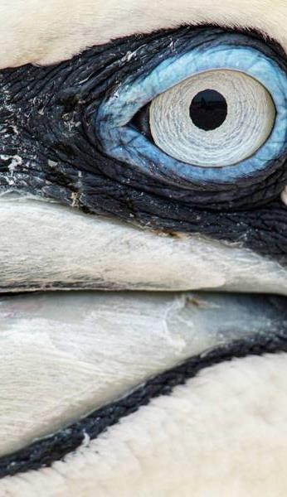
Thank you
Mirjam Nilsson​​
mirjam@contoso.com​
www.contoso.com​

